Slide 1



UNESCO General Education Quality Analysis Framework (GEQAF)
From Diagnosis to programme development and implementation

Slide 2
PRINCIPLES IN APPLYING GEQAF:
Country context at the core: Development relevance means acknowledging that quality education is necessarily contextual and therefore the analysis using GEQAF starts with understanding of the national and sub-national development context of the particular country
Country driven process: GEQAF is purposefully designed as a self-assessment tool for countries to analyse constraints and strengths in their education system, to identify key priorities, design appropriate context responsive interventions.
Participatory process: that the objective of GEQAF is not to grade or compare education systems but rather to guide countries to find for themselves in a fully participatory way why their education is not performing the way they expected it to and what can and needs to be done to address the problems.

Slide 3
GEQAF Phase 1: Diagnosis and analysis
11 countries (Armenia, Botswana, Egypt, Gabon, India, Oman, Peru, Saudi Arabia, Seychelles, South Africa, Swaziland) have used GEQAF to analyse the quality of their education system and prioritize areas for intervention.
The Framework has been translated into seven languages (Arabic, Armenian, English, French, Hindu, Portuguese, Russian and Spanish) reflecting the diversity of countries applying the Framework.
A web-version of GEQAF has been developed with interactive features and with enhanced resources like technical notes and good practices.
More than 10 countries met in Saudi Arabia in 2015 to exchange their experiences from applying GEQAF and identified common challenges facing their education systems.

Slide 4
GEQAF Phase 2: Moving from diagnosis to implementation of interventions:
Five countries have already embarked on the second phase (Botswana, Egypt, Oman, Seychelles, Swaziland) and three more countries are preparing to start the second phase (Gabon, India, South Africa).
IBE is providing technical assistance based on country priorities. The country priorities currently supported by IBE include Early Childhood Care and Education, Competency-based approach to curriculum and learning, integration of ICT in learning and teaching.(Seychelles and Swaziland)

Slide 5
Phase 2 Objectives (usually 2 IBE-missions to a country including international experts
1. Situation analysis (1st mission, one week)
The situation analysis in the selected priority areas.
  How does the system fare in comparison with best practice?
  Laying a strong foundation for programme development

Slide 6
Phase 2 Objectives continues (mission 1)
  2. Clear identification of priorities, outcomes to be achieved, indicators, baseline, benchmarks
  What are the specific areas to be addressed to improve the system from current to good or adequate?
  What are the specific objectives (outcomes) to be achieved in the specific areas prioritised? What are the indicators of success?
Output
Situation analysis

Slide 7
Between mission 1 and mission 2
Detailed work on developing concrete programmes in each of the specific areas
detailed activities required to achieve the specific objectives
Resource requirements (human, technical, infrastructural, equipment)
Approximate cost of the resource requirements (based on some informed estimates to be refined later)
  Realistic financing sources (sustainability)
  What and how the IBE can contribute?

Slide 8
Between mission 1 and mission 2, continues
Deliverable outputs (results frameworks)
Monitoring and evaluation arrangements
Who is responsible for the various activities?
The timeline for the activities
Output
Draft programmes and action plans

Slide 9
Mission 2 objectives
National consultation workshop
Getting input from stakeholders and actors

Slide 10
Phase 2. MP and Meghalaya
No IBE missions
Indian experts to support the states in undertaking the situation analysis, programme development and action plans
IBE will finance the expert inputs
UNESCO will send a delegate for the workshop/workshops

Slide 11
Launching meeting of phase 2, India
To discuss priorities of the states identified for UNESCO-IBE support (from last skype conference)
  Curriculum reform
  Adolecens education
  Guidance and councelling
  ICT pedagogy and teacher training
  EMIS integration
Planned workshops
  25-29 July – Meghalaya
  1-5 August – MP
IBE financial support to be agreed (experts and consultation workshops)

Slide 12
What after programme and action plan development
IBE will mobilise partners to support implementation of the programmes (Google broad support), (Netsle related to ECCE) and several other potential partners
Most importantly, the states can implement to a large extent with their own resources
The IBE commitment is for the next 4 to 5 years depending on availability of resources

Slide 13



BASIC COVER LAYOUTS

Slide 14




BASIC COVER LAYOUTS

Slide 15


BASIC COVER LAYOUT
HOW TO USE THEM
You can select the globe and language spot. Align them horizontally and set size and position as on the cover page.

Slide 16
BASIC SLIDE LAYOUTS
HOW TO USE THEM
You can select the template layout based on your desired page. If you have a photograph with a blue spot→right-click on page thumbnail (left) and select the layout (cover/back/text layout without page number and footer).

Slide 17
BASIC SLIDE LAYOUTS

Slide 18
BASIC SLIDE LAYOUTS

Slide 19
BASIC SLIDE LAYOUTS
If you use slides with full page picture or graphs, do not use the footer.
→right click on thumbnail (left) and choose layout cover/back/fullpage
Title
Text;
Text;
Text; and
Text.

Slide 20
EXAMPLE SLIDES
The design of the pages
should look alike
HOW TO USE THEM
You can copy past the elements you need, and create your own slides.
Delete all the un-necessary pages, or language version.

Slide 21
An international centre of excellence in curriculum
EXAMPLE PAGE
The design of the page
should look alike
The IBE is a leading UNESCO institute in the field of curriculum, valued both for its specialist know-ledge, expertise and networks, and for providing curriculum support services that include up-to-date, evidence-based information and practical support to UNESCO Member States.
The IBE’s mission is to support UNESCO Member States as they seek to enhance most effectively the quality of student learning. Such support is offered mainly through initiatives and activities within the following three key action areas:
capacity development of both institutions and individuals,
as well as technical support and advice;
access to curriculum – related knowledge, experience
and expertise

Slide 22
EXAMPLE PAGE
The design of the page
should look alike
IBE Budgetary Framework 2013
For the financial period 1st January to 30th July in US Dollar
Special Account | Budget Approved | Execution Rate
I. Programme Activities | 0000 | 0%
I-1 Capacity Development & support services to MS | 0000 | 0%
I-2 Clearing-house & information management | 0000 | 0%
I-3 Curriculum research & Policy Dialogue | 0000 | 0%
II. Governing Board/ Gen. Adm./Institutional Dev. | 0000 | 0%
III. Staff costs | 0000 | 0%
Total Special Account July 2013 (I + II + III) | 0000 | 0%

Slide 23
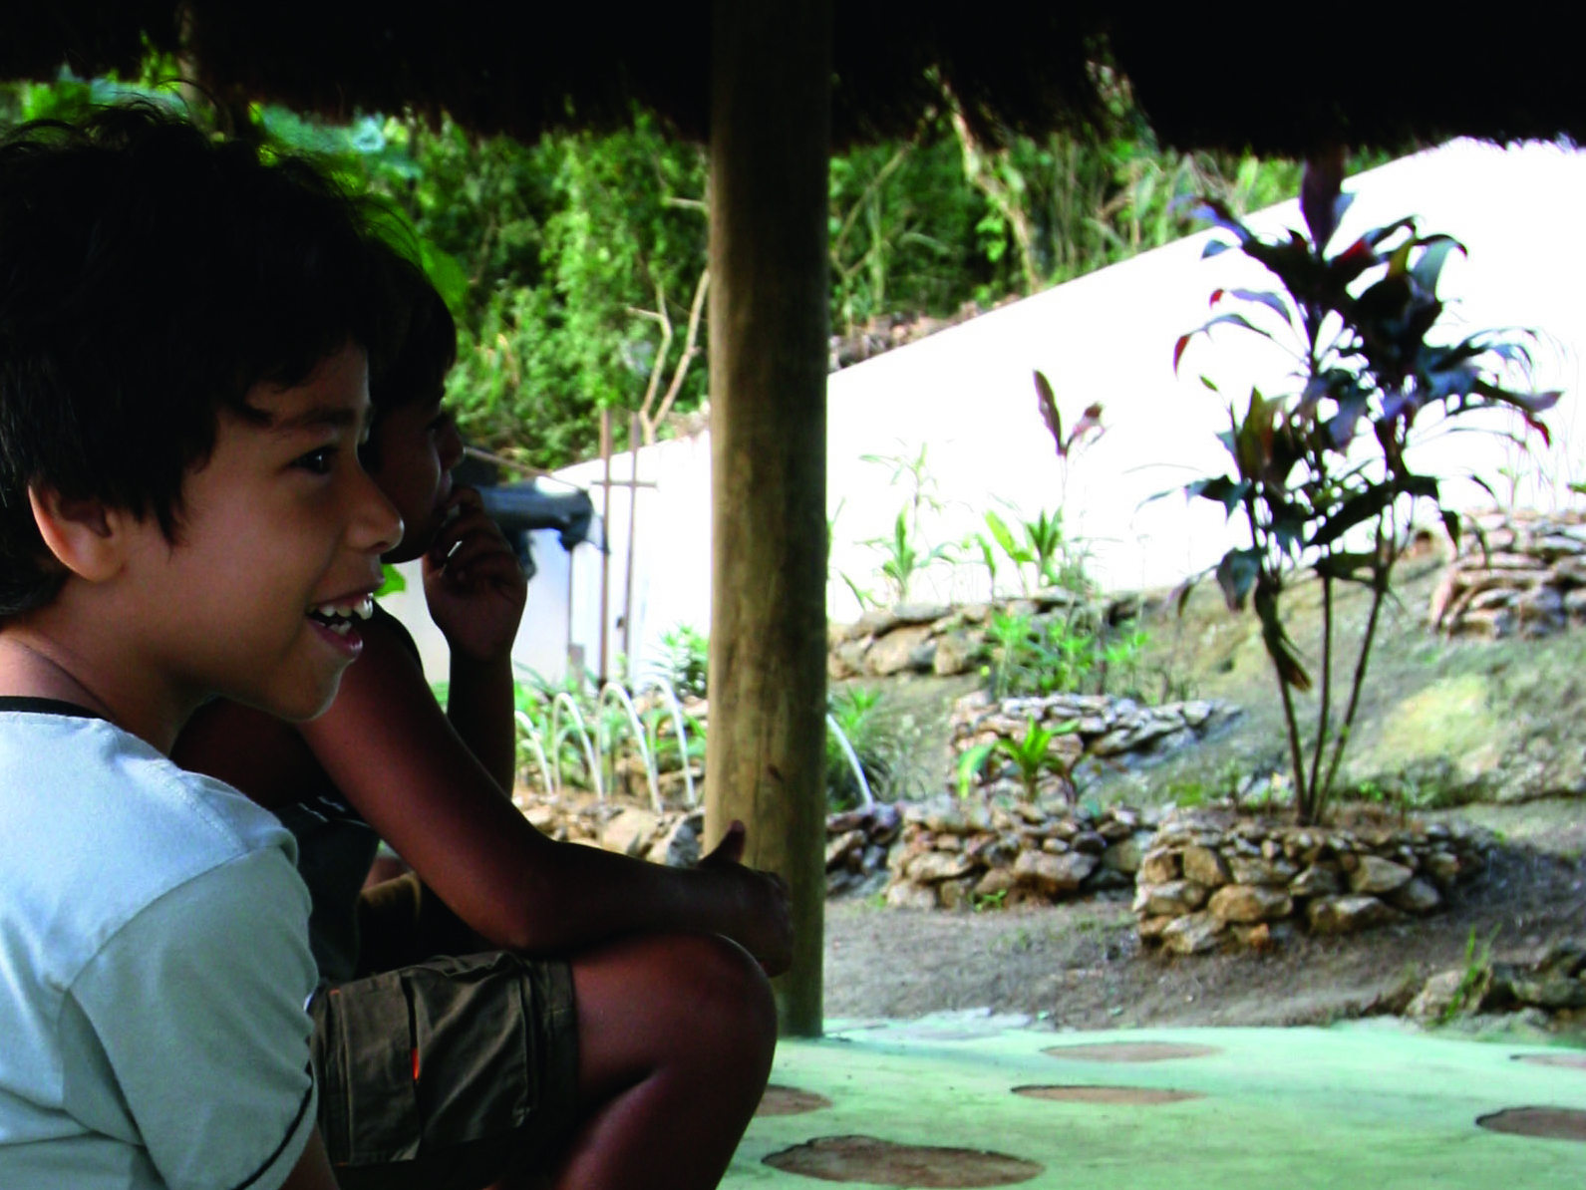
EXAMPLE PAGE
The design of the page
should look alike
IN 2012
685 curriculum specialists participated
in the IBE’s professional activities;
194 curriculum specialists from 44 countries around the world participated in the IBE’s Diploma programmes;
24 countries (18 in Africa) received specific technical assistance in curriculum development; and
downloads through UNESDOC of IBE curriculum documents and publications exceeded 300,000.

Slide 24
EXAMPLE PAGE
The design of the page
should look alike
An international centre
of excellence in curriculum
The IBE is a leading UNESCO institute in the field of curriculum, valued both for its specialist know-ledge, expertise and networks.
Policy
dialogue
Evaluation & Assessment
Curriculum design
Curriculum change
Processes
Of curriculum
implementation
System
Management &
governance
Capacity
building
Textbooks
& other
materials

Slide 25
EXAMPLE PAGE
The design of the page
should look alike
GOAL A
Develop programmes and services that are relevant and responsive to the needs of Member States, innovative and effective in nature and, above all, of high quality
June
Dec 2011
Jan
June 2012
July
Dec 2012
Jan
June 2013
July
Dec 2013
Jan
June 2014
Strategy A1
The IBE should clearly define its priorities: what it must do as its core functions and services, what it should do given additional resources and what it should “refer” to other institutions better for the task.
Based on the IBE’s field work and consultations with its partners, a set of important, relevant and current topics have been compiled.
Expert meeting to help develop research considering regional needs
New agreements with academic partners (e.g. International Academy of Education IAE; Geneva University – FAPSE; International School of Geneva
A1
A2
A3
A4

Slide 26
EXAMPLE PAGE
The design of the page
should look alike
Organigram 2013-2014
Outcomes 2012-2017
Action area
Strategic goal
Outputs
Programmatic
Cross-programmatic
Long-term
Capacity Development
Enhance the capacities of individuals and institutions for the design, management, implementation and assessment of quality-making curriculum processes
Training tools,
Resource packs, Workshops,
Diplomas,
Policy dialogue,
Technical assistance and policy advice
Long-term accredited diploma courses on curriculum design and development organized and implemented
Enhanced partnerships to maximize the use of relevant resources, expertise and experiences
Improved capacities to design, manage and assess high quality curricula
Improved availability of training tools for capacity development in the field of curriculum
Increased networking to facilitate and support exchange on curriculum issues and policies
Increased commitment to adopt effective curriculum policies
Communities of practice on curriculum development issues and trends further developed
Improved curriculum development processes and products
Strengthened international, regional and sub‑regional cooperation
Increased
production
of thematic
training tools

Slide 27
INTERNATIONAL
BUREAU OF EDUCATION
www.ibe.unesco.org
Tel +41 22 917 78 00 – Fax +41 22 917 78 01
Postal address
P.O. BOX 199, 1211 Geneva 20,
Switzerland
Street address
15 Route des Morillons,
1218 Le Grand-Saconnex,
Geneva, Switzerland

